Slide 1
FDP
From Pipelines to Production
Dr. Shreyas Rao
Professor, Dept. of CSIS, BITS-Pilani

Slide 2
Day 3
The Generative System: RAG, LLMOps and AgentOps

Slide 3
LLMOps

Slide 4
What is LLMOps
LLMOps, or large language model operations, refers to the practices and processes involved in managing and operating large language models (LLMs)
LLMOps is a specialized subset of MLOps (machine learning operations), which focuses specifically on the challenges and requirements of managing LLMs
https://cloud.google.com/discover/what-is-llmops

Slide 5
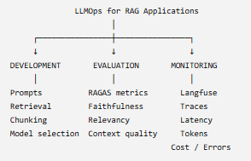
What is LLMOps
Perspective
In this workshop, we are looking at LLMOps from the perspective of an LLM-powered RAG application, rather than from the perspective of developing and training the underlying foundation model.

Slide 6
LLMOps Tools
LLMOps Area | Tool | Purpose
LLM Model / Embedding | OpenAI API | Generate responses and embeddings
RAG Framework | LangChain | Build the RAG pipeline
Vector Database | ChromaDB | Store and retrieve document embeddings
Document Processing | PyPDF / PyMuPDF | PDF ingestion and text extraction
Observability / Tracing | Langfuse | Trace LLM calls, prompts, retrieval, latency, tokens, costs, errors
Evaluation | RAGAS | Evaluate RAG quality using metrics such as faithfulness, answer relevance and context relevance
Experiment Tracking | Langfuse | Compare runs, prompts, models and performance
Prompt Management | Langfuse | Store/version prompts and evaluate prompt changes
Dataset / Test Set | JSON | Maintain question–answer–context evaluation datasets
Application | Streamlit | Build a RAG application/UI
Configuration / Secrets | .env | Manage API keys securely
Development | VS Code | Development and experimentation

Slide 7
RAGAS framework for RAG Evaluation
https://www.ragas.io/

Slide 8
RAGAS Framework for RAG
Evaluating Generative AI Applications
RAG: Retrieval-Augmented Generation (combining LLMs with external databases).
The Problem: Traditional metrics (BLEU, ROUGE) are inadequate for measuring hallucination and context relevance.
RAGAS: Retrieval Augmented Generation Assessment.
Objective: An automated framework using an LLM evaluator to score the distinct components of a RAG pipeline without human labels.
https://www.ragas.io/

Slide 9
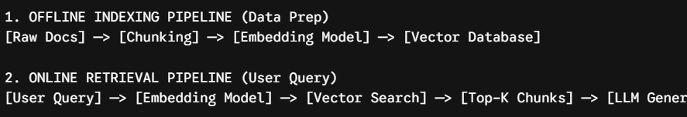
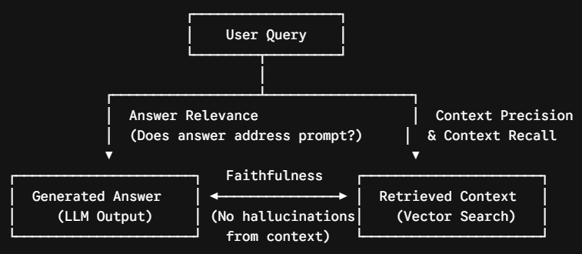
RAG Two-Pipeline Architecture
Understanding What to Evaluate Every RAG system has two distinct paths that must be optimized and evaluated independently.

Slide 10
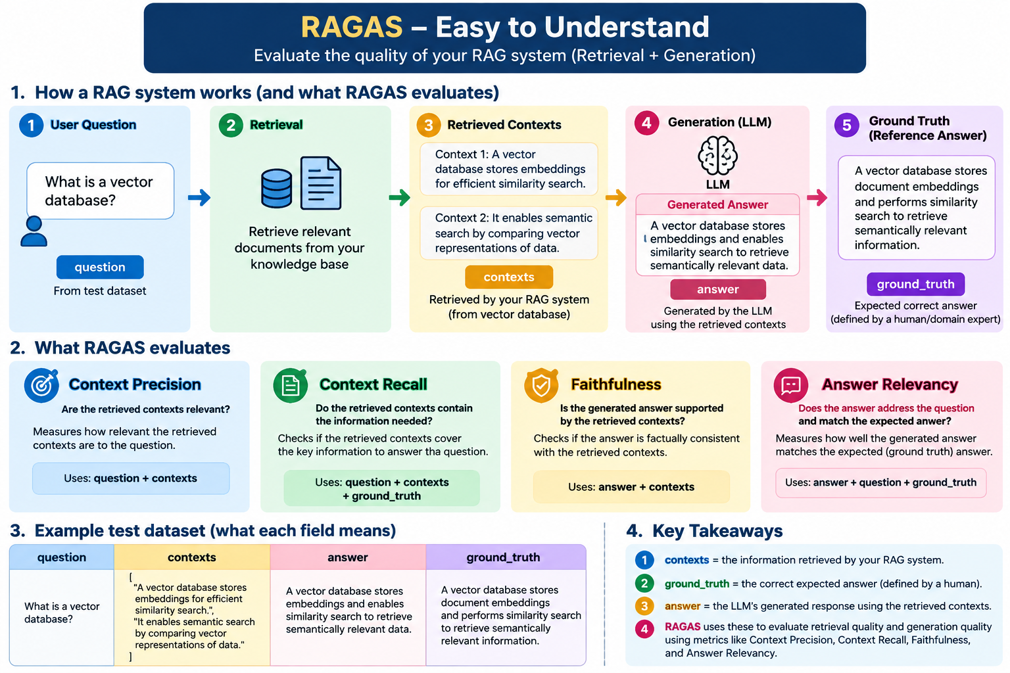
RAGAS

Slide 11
Core Metrics in RAGAS
Evaluating the Generator (The LLM)
Faithfulness: Measures if the generated answer is strictly grounded in the retrieved context to detect hallucinations.
Answer Relevance: Measures how well the generated answer directly addresses the user's initial prompt.
Measurement Tool: RAGAS uses foundation models as an automated judge to score these dimensions.
Evaluating the Retriever (The Vector Search)
Context Precision: Evaluates if the top retrieved chunks are highly relevant to the query, rather than just noise.
Context Recall: Ensures that the retrieval mechanism successfully fetched all the necessary facts required to answer the question.
Balance: High precision means no junk data; high recall means no missing facts.

Slide 12
Langfuse

Slide 13
Langfuse
Langfuse is an LLM observability platform that enables tracing, monitoring, debugging, and analysis of LLM applications, making it an important component of the LLMOps lifecycle
Captures answers for the following questions
What did the LLM do?
Why did it produce this answer?
How long did it take?
How many tokens did it use?
What context was retrieved?
How much did it cost?
Was the answer grounded?
https://langfuse.com/

Slide 14
RAGAS - Practical
ragas-demo.py

Slide 15
Steps
Take the RAG application code
Update “requirements.txt” file to include langfuse and ragas
In the terminal, execute “pip install -r requirements.txt”
Add “eval.json” file [new] – add questions relevant to your datastore
Register for the free langfuse account at “cloud.langfuse.com”; select any region and login with your gmail (personal) credentials
Create a new project in langfuse and generate API keys for them
Go to “Tracing” -> “Create API Keys” -> Copy the “.env” settings and paste inside the local “.env” file
Change “langfuse_base_url” to “langfuse_host”
Update the “.env” file to include langfuse
Update config.py file with langfuse details
No changes in “ingest.py” since during ingestion, we don’t use monitoring
Update “rag.py” to include langfuse
Add “evaluate.py” to include langfuse + ragas [new]
Update “app.py” to include langfuse code + ragas
Sequence of execution -> “python ingest.py”, “python evaluate.py” and “streamlit run app.py”

Slide 16
What to observe in Langfuse?
Scores under Evaluation
Sessions
Tracing
[Original code -> Final Code -> Basic Rag
Changes -> rag-increment-llmops]
rag-increment-llmops.py

Slide 17
LLMOps – Additional Metrics
Term | Meaning
answer_length_words | Number of words in the generated answer.
ragas_answer_relevancy | Measures how directly the generated answer addresses the user's question.
ragas_conciseness | Measures whether the answer is concise and avoids unnecessary information.
ragas_faithfulness | Measures whether the answer's claims are supported by the retrieved context.
ragas_llm_context_precision_without_reference | Measures how precisely the retrieved context contains information relevant to the question, without using a reference answer.
ragas_nv_context_relevance | Measures how relevant the retrieved context is to the user's question.
ragas_nv_response_groundedness | Measures how well the generated answer is grounded in the retrieved context.
refused_to_answer | Indicates whether the system refused to generate an answer.
retrieval_mean_score | Average similarity score of all retrieved chunks/documents.
retrieval_top_score | Similarity score of the highest-ranked retrieved chunk/document.
top_source | The source document associated with the highest-ranked retrieved content.
unique_sources | Number of distinct source documents used in the retrieved context.
llmops-additionalmetrics.py

Slide 18


Slide 19
Appendix – Overall Metrics
Category | MLOps (Predictive Models) | LLMOps (Large Language Models) | AgentOps (AI Agents)
Primary Goal | Accurate predictions | High-quality text generation | Successful autonomous task execution
Model Quality Metrics | Accuracy, Precision, Recall, F1-score, ROC-AUC, RMSE, MAE | BLEU, ROUGE, BERTScore, Exact Match (EM), Semantic Similarity, Hallucination Rate | Task Success Rate, Goal Completion Rate, Decision Accuracy
Operational Metrics | Inference Latency, Throughput, Model Drift, Data Drift | Token Latency (TTFT, Tokens/sec), Response Time, Cost per Request, Token Usage | End-to-End Task Latency, Workflow Completion Time, Agent Utilization
Reliability Metrics | Model Availability, Prediction Error Rate | Response Consistency, Hallucination Rate, Safety Violations | Task Failure Rate, Recovery Rate, Retry Success Rate
Data Metrics | Data Quality, Missing Values, Feature Drift, Data Freshness | Prompt Quality, Context Window Utilization, Retrieval Accuracy (for RAG) | Memory Retrieval Accuracy, Context Retention, Knowledge Freshness
Efficiency Metrics | CPU/GPU Utilization, Batch Throughput | Token Consumption, Cost per 1K Tokens, GPU Utilization, Cache Hit Rate | Number of Tool Calls, Planning Efficiency, Resource Utilization
User-Centric Metrics | Prediction Accuracy, Business KPIs | User Satisfaction, Helpfulness, Relevance, Human Evaluation Scores | User Task Success, User Satisfaction, Number of Human Interventions
Monitoring Focus | Model degradation and data drift | Prompt performance, hallucinations, token usage, response quality | Agent reasoning, planning, tool usage, memory, collaboration, task execution

